Slide 1
UNIT-III. Chemical kinetics
III YEAR
SEMESTER-V
Paper - VI (INORGANIC, ORGANIC & PHYSICAL CHEMISTRY)
By
Medavarapu Sri Teja B Venkata Ratnam. M. Sc
Guest Faculty in Chemistry
P.R. Government College (A) Kakinada.

Slide 2
Contents
Rate of chemical reaction
Order and Molecularity of chemical reactions

Slide 3
Chemical Kinetics
Definition:-
The branch of physical chemistry, which deals with the study of reaction rates and their mechanism, called as chemical kinetics.

Slide 4
Rate of a chemical reaction:-
“ The rate of a reaction can be defined as the change in concentration of a reactant or product in unit time”
The rate of a reaction tells us to what speed the reaction occurs.
Let us consider a simple reaction- A -----> B
The concentration of A decreases and the concentration of B increases with time.

Slide 5
As you know during the progress of a reaction
the concentration of A keeps on falling with time.
The rate of reaction at any given instant is given by the expression-
r= –dCA/dt = kCA ……………………….(1)
where :-
–dCA is very small decrease in concentration of A in a very small time interval dt,
CA gives the concentration of the reactant A at a given instant k is constant called the rate constant or velocity of the reaction.

Slide 6
Now the concentration of product B increases with time. Hence rate of reaction can also be expressed in terms of increase in concentration of the product B as well.
Thus
r= dCB/dt = kCA ………………………….(2) where:-
dCB is very small increase in the concentration of product B in a very small time interval of time dt.

Slide 7
Now it should be clear to you from (1) and (2)
r= - dCA/dt =dCB/dt= kCA
and for a reaction A+B -----------> M+N the rate can be expressed
r= -dCA/dt = -dCB/dt = dCM/dt=dCN/dt=kCACB ………………(3)

Slide 8
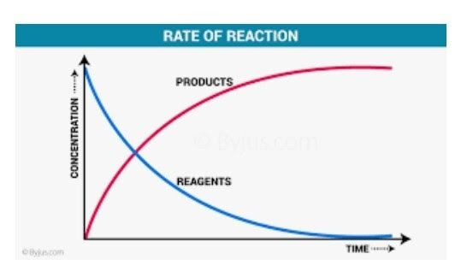

Slide 9
As the reaction proceeds the reactants are consumed where their molecular concentration decreases. Hence the rate of a chemical reaction will also decrease with
time.
Now it should be clear to you that reaction velocity is maximum to start with and then falls gradually with time.
The reaction velocity become so slow in the latter states that it takes a very long time for the reaction to be completed.

Slide 10
It can be safely assumed that in the
later stages the reaction is nearly complete.
Now let us consider a reaction- aA+bB ------------> cC+dD
In this reaction a moles of A reacts with b moles of B to form c moles of C and d moles of D.
The rates of such a reaction can be expressed either in terms of decrease in concentration of a reactant per mole or increase in concentration of a product per mole.

Slide 11
Thus we can write as follows:
r= -1/a dCA/dt = -1/b dCB/dt =1/c dCC/dt = 1/dCD/dt = k Cª C^{b}
A B
Units of rate :-
Reaction rate has the units of concentration divided by time. We express concentration in moles per litre (mole/litre) but time may be given in any convenient unit second(s), minutes (min), hours (h) days (d) or possibly years.
Therefore, the units of reaction rates may be mole/litre/sec or mole/litre/ minute

Slide 12
Order of reaction:-
The order is the number of concentration terms on which reaction rates depends.
Thus,
if the rate of a reaction depends on the first power of the concentration of reactant, i.e.
Rate = KC1
Thus the reaction is said to be of the first order.

Slide 13
When the rate is proportional to the product of two reactant concentrations or the square of the concentration of a reactant,the reaction is of the second order.
If the reaction rate is experimentally found to be represented by
−dC = KC^{n}
dt
The order of the reaction is n.

Slide 14
If several reactants A, B, C, . . . . . . .etc are involved and it is observed experimentally that the rate of the process is given by,
−dc = KC^{α} C^{β} C^{γ}
A B C
dt
.......
Then the order of the reaction would be n = α+β+γ+....... The reaction is said to be α th order with respect to A, β th order with respect to B etc.

Slide 15
But there are reactions in which the order is fractional i.e. n =1 ,3
2 2
Molecularity of a reaction:-
The molecularity of a reaction is defined as the number of molecules or atoms which
take part in the process of a chemical change.
(or)

Slide 16
Molecularity in chemistry is the number of molecules that come together to react in an elementary reaction and is equal to the sum of stoichiometric coefficients of reactants in this elementary reaction.
The reaction is said to be unimolecular, bimolecular, termolecular according to one,two, or three molecules are involved in the process of a chemical change.
The term unimolecular was used for all first order reactions, the term bimolecular for 2nd order reactions etc.

Slide 17
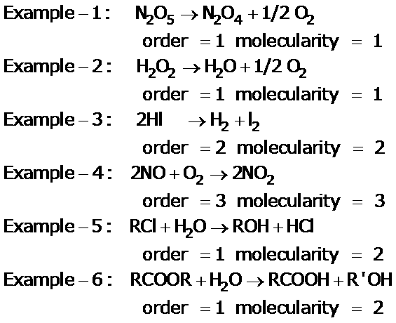
Examples:-

Slide 18
Differences between order and molecularity:-
Molecularity | Order of reaction
It is equal to the number of molecules of reactants which take part in a chemical reaction. | It is equal to some of the power of the molar concentration of the reactants in the rate expression.
It is theoretical concept. | It is an experimentally determined quantity, which is obtained from the rate for the overall reaction. It depends on rate

Slide 19
 | determining step in the reaction mechanism.
It is always a whole number. | . It may be negative, zero or fractional value generally not more than 3.
It is obtained from a single balanced chemical equation. | It cannot be obtained from a balanced chemical equation
It does not reveal anything about reaction mechanism. | It reveals some basic facts about a reaction mechanism.

Slide 20
Thank you

